Slide 1

SCHOOLBOOK
Sean Marino
Steffano Soh
Nicholas Dugal
Zachary Robicheaux
Clayton Samson
Justin Bougere

Slide 2

Contents
Mission Statement
Features
Technical Details
ER Diagram
Demo

Slide 3

Redefining Interactive Studying
Purpose
SchoolBook is a web application that was produced to augment the studies of college students
Easy access to study groups and class notes

Slide 4

Features
Students can enroll in courses that they are taking.
Students can work together by creating a study group.
Students can help each other by registering as a tutor and uploading their notes.

Slide 5

Technical Details
Database Design/Front End Design
Application Development
Server configuration

Slide 6
S: Size of code in KLOC
1000 = 1k
2,800 lines = 2.8KLOC

Slide 7
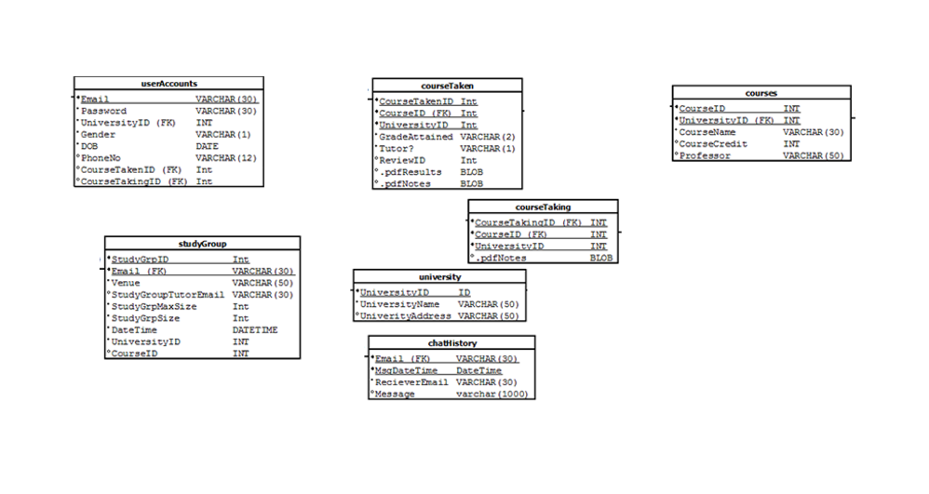




Slide 8






SchoolBook Team
Steffano Soh
Clayton Samson
Nicholas Dugal
Sean Marino
Justin Bougere
Zachary Robicheaux

Slide 9
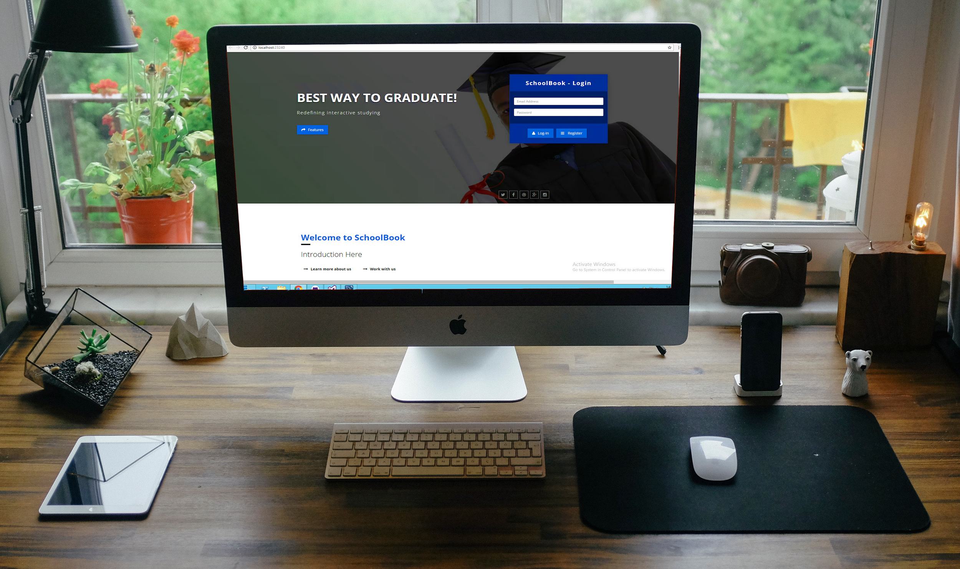
Demo

